Slide 1
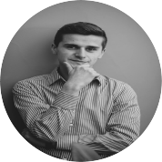
Beyond Vision
Beniamin
Tech enthusiast &
Hardware researcher
3nd year Computer engineering student
Advisor:
Alin Grama

Slide 2

Steganography
Steganography is the art and science of sending covert message and the existence of these messages are only known by the sender and the receiver.
This technique has been practiced for thousands of years.

Slide 3


Benefits of steganography
Communicate securely
Could be very useful in copyright

Slide 4
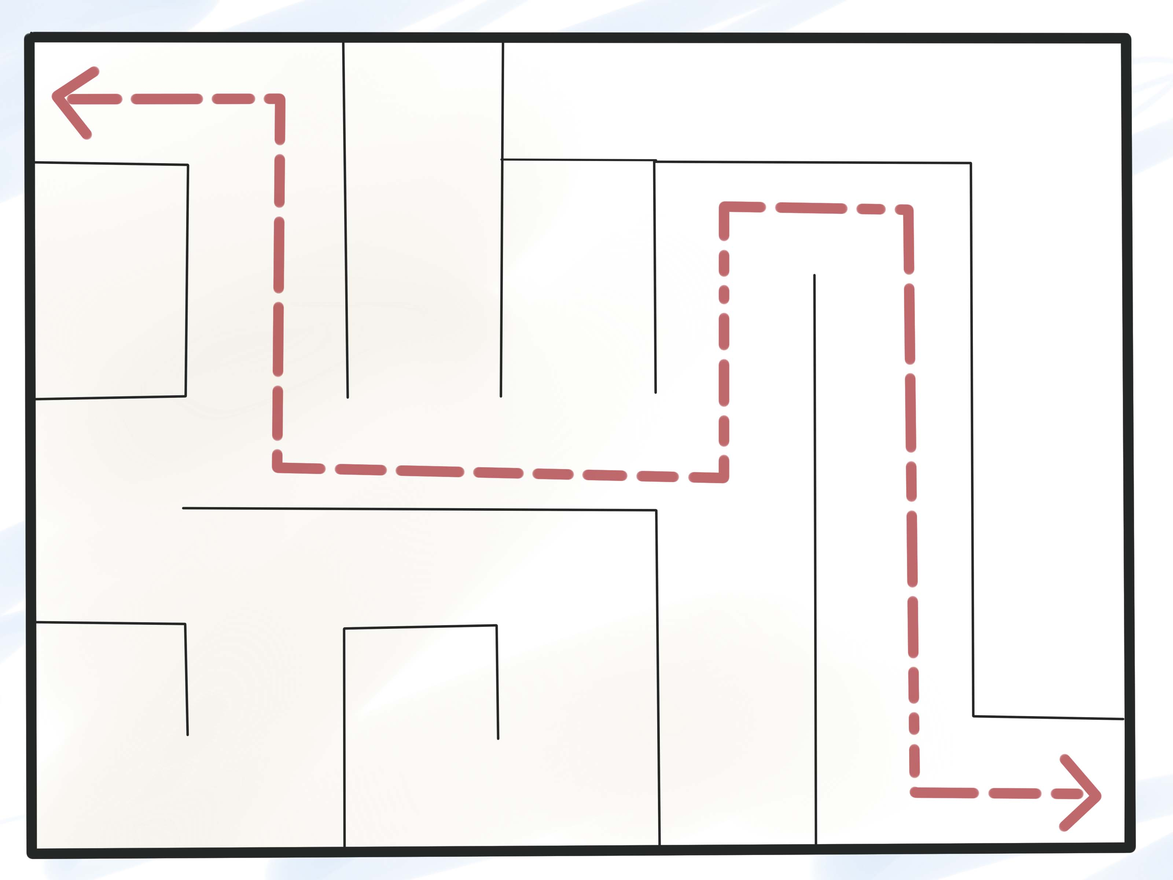
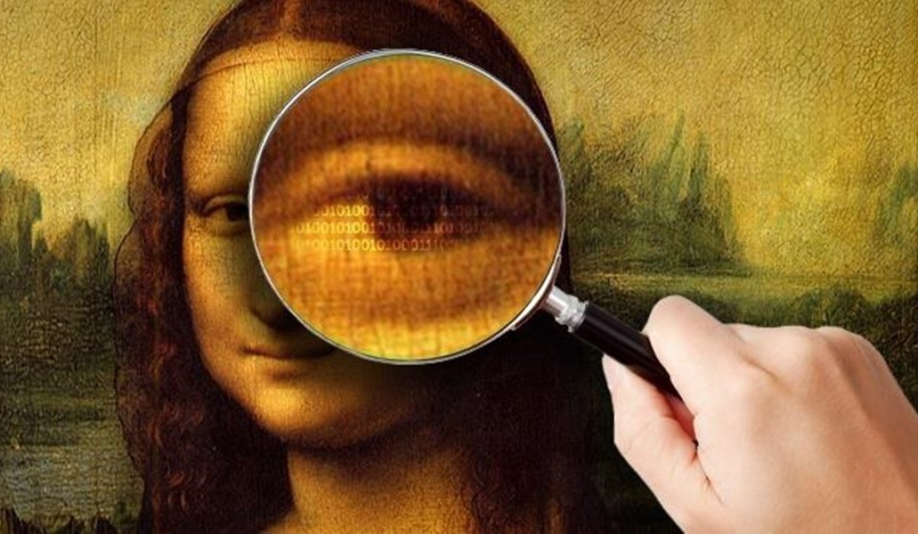
Benefits of steganography
Could not be traced
Allows encrypted communicates without being detected

Slide 5
Is steganography really useful?
British Prime Minister Margaret Thatcher used this to identify the informer
US and USSR were transmitting information about nuclear facilities without revealing the receiver location
You may not be the only one reading your private messages on social media, steganography could make it unbreakable

Slide 6
Our solution
A highly secure server which is hardware accelerated to embed and extract hidden data inside images and sound

Slide 7
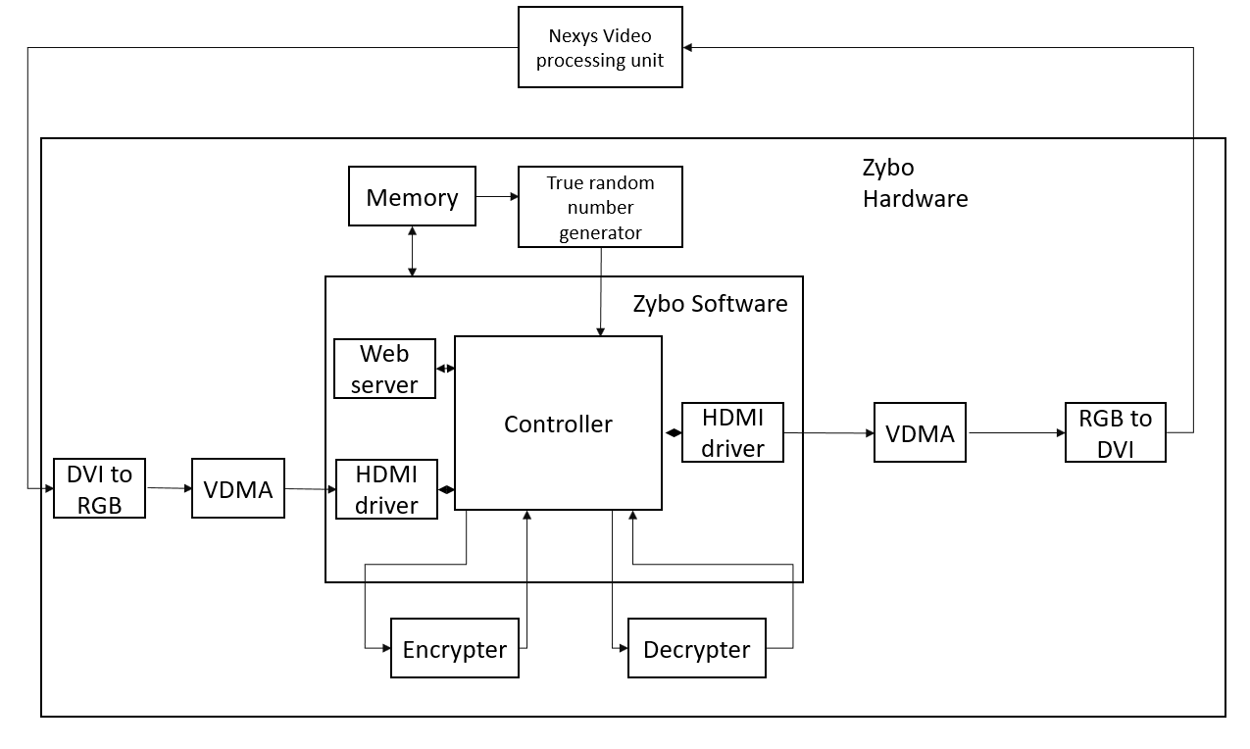
So how does it work?

Slide 8
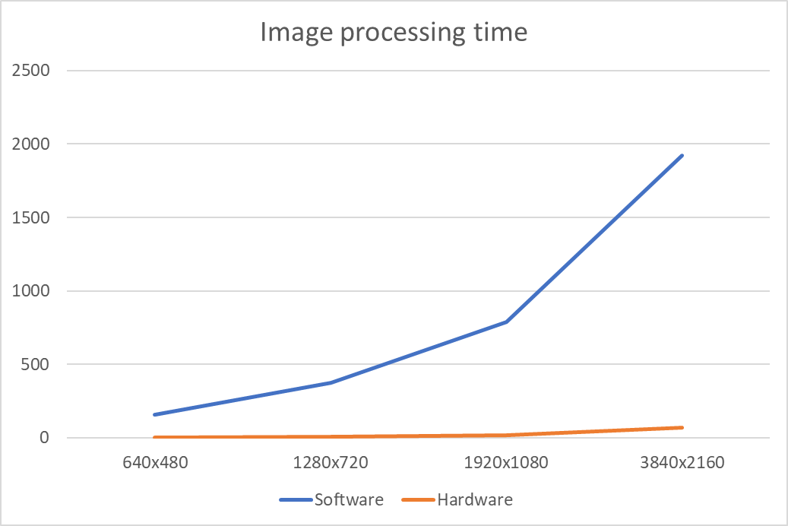
Performance

Slide 9
Comparison
 | Medium computer CPU + Memory + Motherboard + Power supply + Storage + Case | ARM/FPGA
Price | > 2000 lei | 1600 lei
Power on load | >300W | 4.1W
Monthly cost | > 200 lei | 10 lei

Slide 10
Main features?
Hardware accelerated cryptography algorithms
Hardware accelerated Image Steganography
Hardware accelerated Sound Steganography
True random number generator for generating certificates
HDMI video processor
Easily integrated with exposed API
Chat App integrated
Real time operating system
Drivers for Linux Kernel developed

Slide 11
Development Stages
Exploring possibilities
and research
Develop processing unit
Build base platform for Linux
Modifying and compiling Linux
Develop Linux module to work with HDMI
Create hardware modules for encryption and decryption
Create hardware modules for random generator
Web service
Presentation
Refactoring

Slide 12
Further development
Parallelization more the encryption and decryption to get better performances
Optimize architecture
Accelerate multiple video algorithms

Slide 13
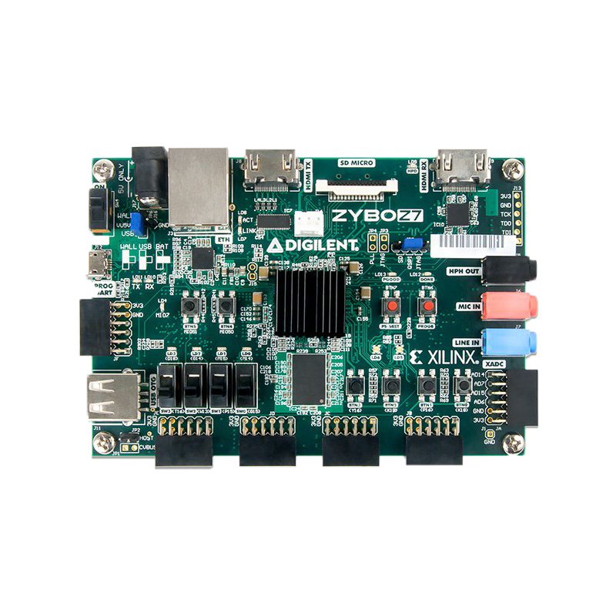

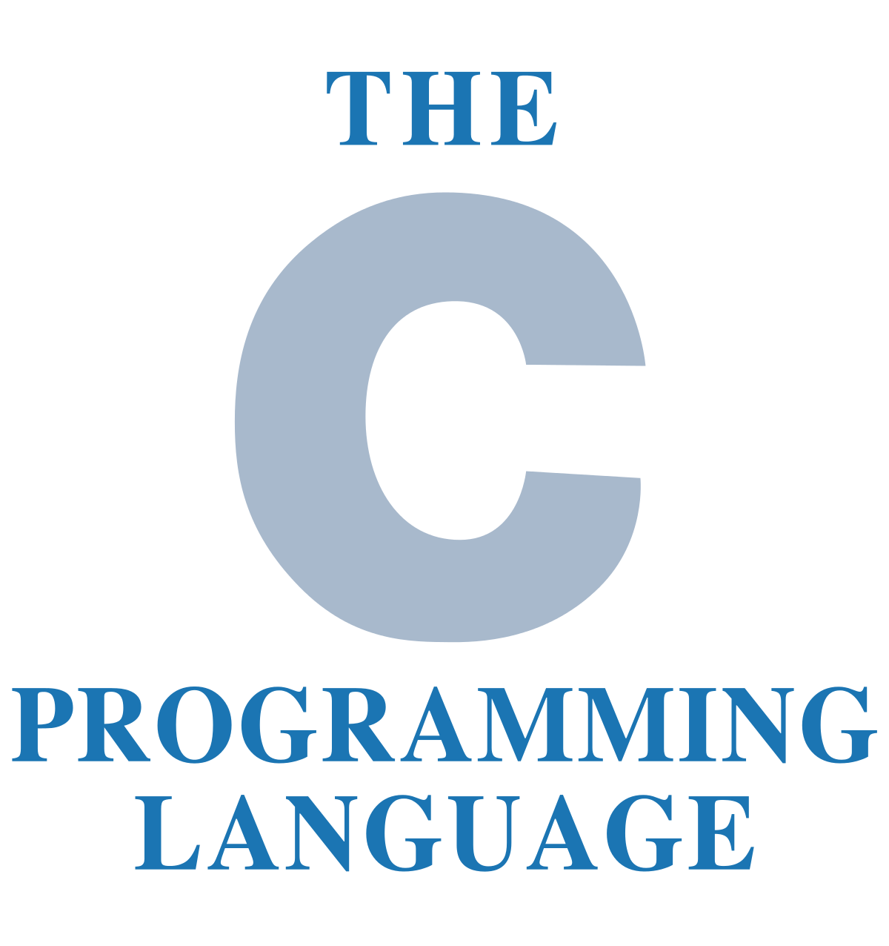
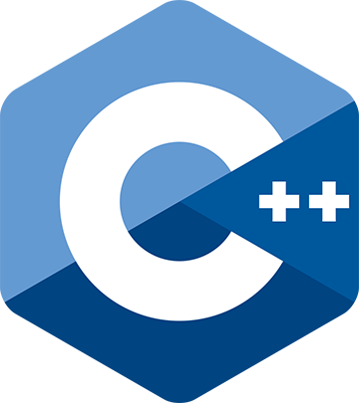
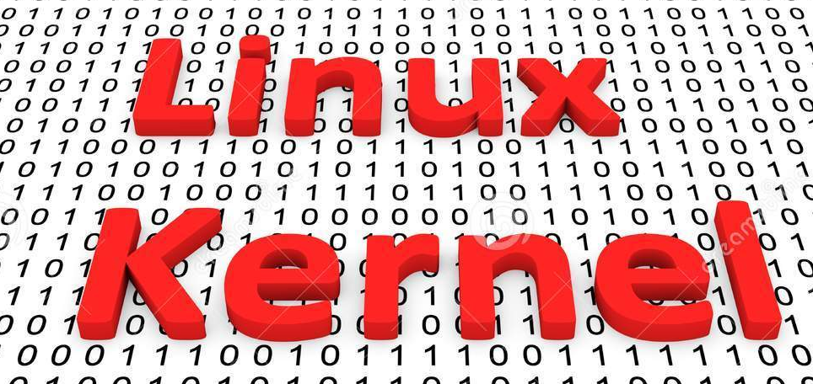

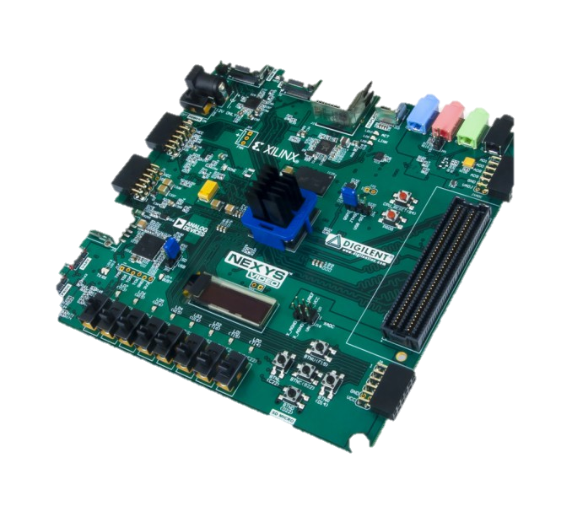
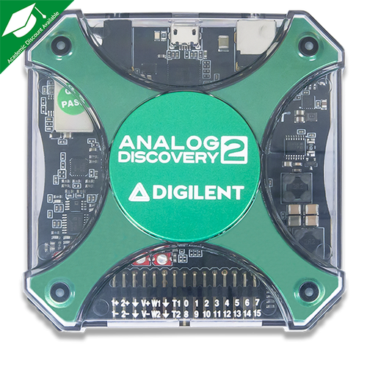




What we used in order to create the platform:
Notes:
In order to develop this we have used: POZE CU LOGOURI SI ZENZORI <- DE ADAUGAT

